Slide 1
CLASS 24,25
Dated 7 April , 2025
Course Title: 5G and Wireless Technology
Course Code : ECE829
MODULE 1 of the Syllabus:-
5G Multiple ACCESS : NOMA ( Non-Orthogonal Multiple Access)
Prof.(Dr.) Rabindranath Bera (Professor, IIIT, KALYANI)
E-mail: rbera@iiitkalyani.ac.in; Mobile : 9475513358
i

Slide 2
5G Multiple ACCESS OMA ….Orthogonal Multiple Access NOMA ...Non-Orthogonal Multiple Access

Slide 3
5G Multiple Access : OMA ( Orthogonal Multiple Access)

Slide 4
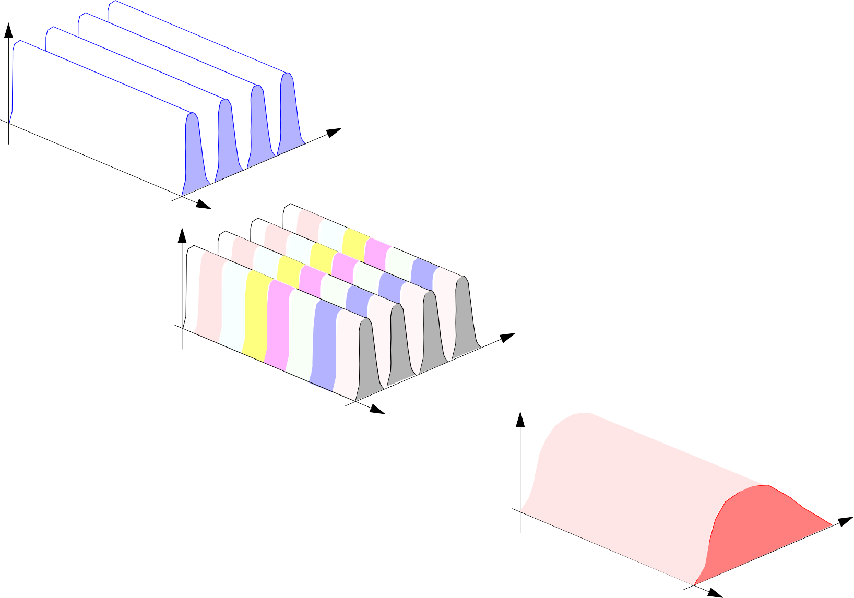
F-/T-/CDMA
Top
14.2
Power
One call per 30kHz (AMPS)
Frequency re-use factor of 7 (carrier to interference ratio 18dB) One call per 210 kHz
Time
Frequency
FDMA
Power
Three time slots per 30kHz Frequency re-use factor of 7 One call per 70 kHz
TDMA
Time
Frequency
Power
Wideband Spectrum
Typical frequency re-use factor of 3/2 One call per 10kHz average
CDMA
Time
Frequency

Slide 5


Notes:
Multiple Access and Detection
Top
FDMA is clearly the simplest method of bandwidth allocation for a channel. For simple FDMA no other users are accessing the same spectrum from within the same cell.
Techniques of TDMA and FDMA are in widespread use within mobile communication. Hybrid schemes are also popular whereby TDMA/FDMA are used together, or perhaps FDMA/CDMA together.
CDMA has multiple users all using the same wideband channel simultaneously. Individual users are selected by correlation processing (or matched filtering) with a pseudo random spreading sequence.
GSM for example is a hybrid TDMA/FDMA system. 200kHz channels are assigned (FDMA) and within the data bursts in these channels, time slots are assigned for different users.
Ver 09.725

Slide 6
AGENDA
Why NOMA in 5G
NOMA in 5G simulation
NOMA in 5G use cases
Review of Paper ‘Energy Efficiency Optimization for NOMA-Based Cognitive Radio With Energy Harvesting’
Case Study of ‘NOMA in 5G’ use cases in SMART AUTONOMOUS VEHICLE
Review the Book :- ‘ Wireless Information and Power Transfer: Theory and Practice’ By IEEE and Wiley

Slide 7
TDMA
Top
14.3
TDMA (Time Division Multiple Access): Several users time-share a common carrier frequency.
user 1
user N
time slot
TDMA frame
user 2
user 1
Power
TDMA frame
Frequency
user 1
user 2
user N
Time
Interference between users is prevented by strict adherence to time slots

Slide 8
Notes:
Multiple Access and Detection
Top
TDMA is used in several cellular and personal communication systems (PCS). The second generation cellular systems which use TDMA are:
GSM (Europe)
IS-54 (US)
PDC (Personal Digital Cellular, Japan)
The wireless PCS which make use of TDMA techniques are:
DECT (Digital European Cordless Telecommunications, Europe)
PHS (Personal Handyphone System, Japan)
WACS or PACS (Wireless Access Communications Systems or Personal Access Communications Systems)
For more information
D. Falconer, F. Adachi and B. Gudmundson. “Time Division Multiple Access Methods for Wireless Personal Communications”. IEEE Comms. Mag., Vol. 33, No. 1, pp. 50-57, Jan. 1995.
Ver 09.725

Slide 9
TDMA frames
Top
14.4
TDMA frames can be organized in two different ways to allow full- duplex communications:
TDD (Time Division Duplex): Frame is divided in slots used in the uplink and in the downlink, which use the same carrier frequency
FDD (Frequency Division Duplex): Two different frames are allocated for the uplink and downlink in different carrier frequencies
TDD: Time Division Duplex FDD: Frequency Division Duplex
TDMA (TDD) frame
upstream frame
upstream slots
downstream slots
downstream frame

Slide 10
Notes:
Multiple Access and Detection
Top
FDD is used in GSM, IS-54, PCD and PACS, while DECT and PHS use TDD. As important advantages and drawbacks of both techniques the following can be mentioned:
FDD:
It requires less transmission bandwidth than TDD
It requires less precise synchronisation of upstream and downstream transmission which is necessary to minimize interference
TDD:
Duplex radio equipment required is simpler than that for FDD since a single carrier is used
Upstream and downstream traffic allocation can be quite flexible, as they use the same carrier
Ver 09.725

Slide 11
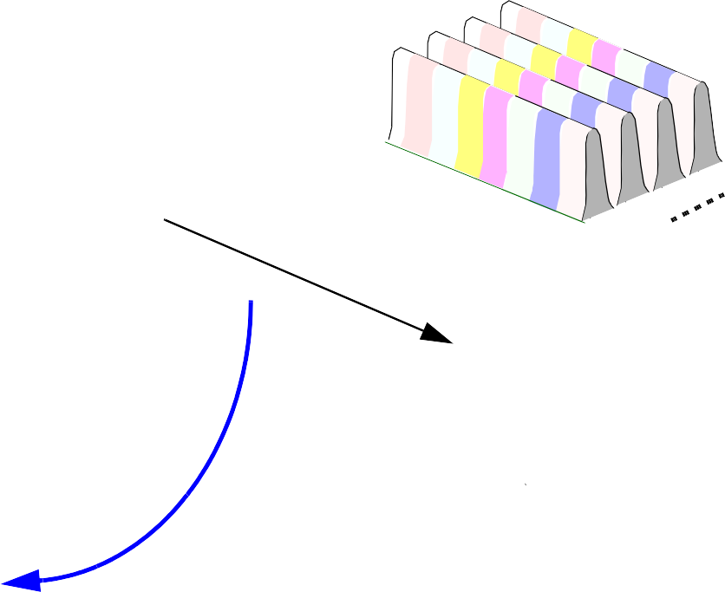
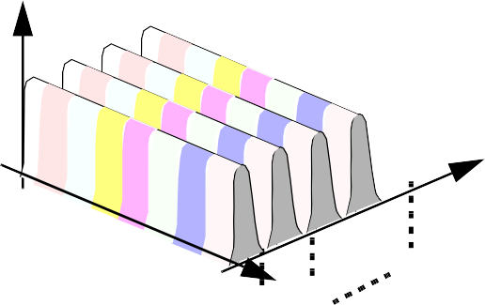
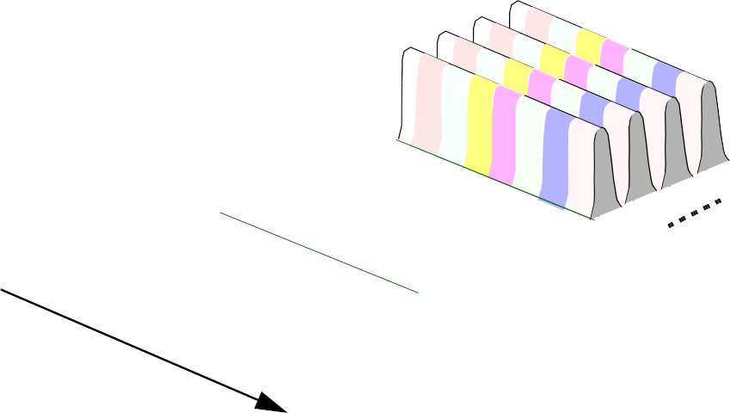
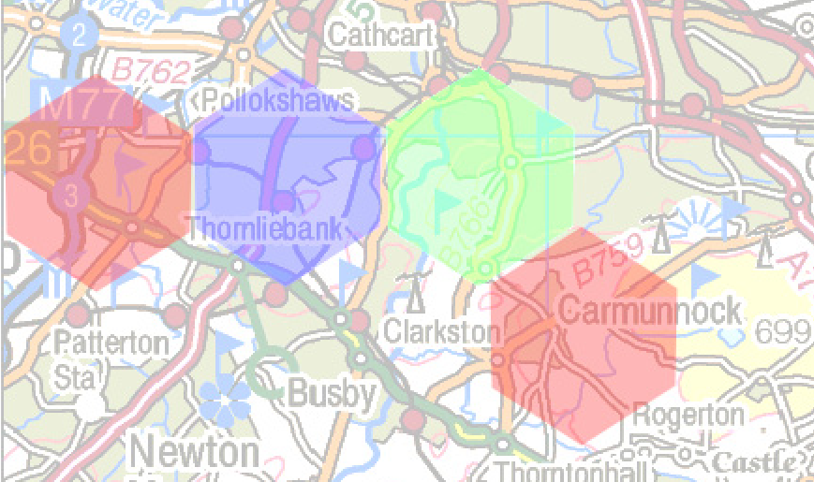
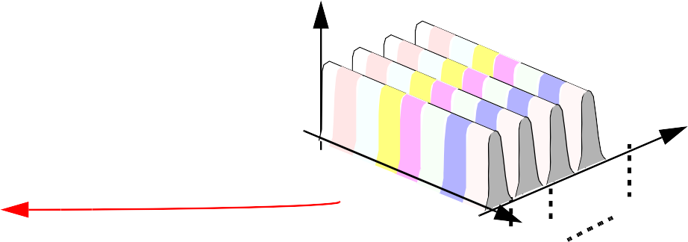

TDMA combined with FDMA
Top
14.5
It is common to combine TDMA with FDMA
Power
Freq.
^{f}2N
^{f}N + 2
Freq.
Time
f
Time
^{f}N + 1
f₂
N
f
1
f
2N
f
N + 2
f
N + 1
Time
cell 1
cell 2
cell 3
Power
Freq.
cell k
Time
f_{N}
f₂
f
1
Frequency reuse is applied only to distant cells to minimize interference

Slide 12
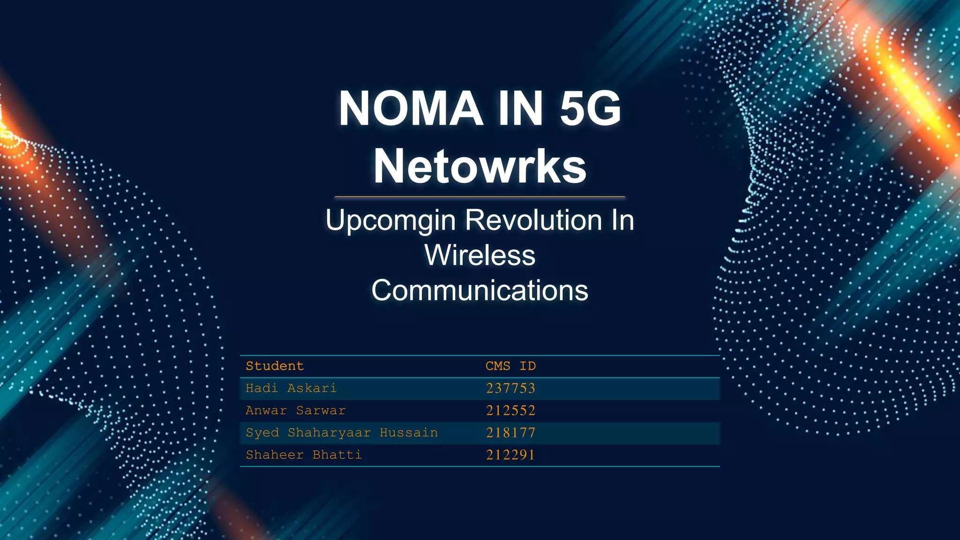

Slide 13
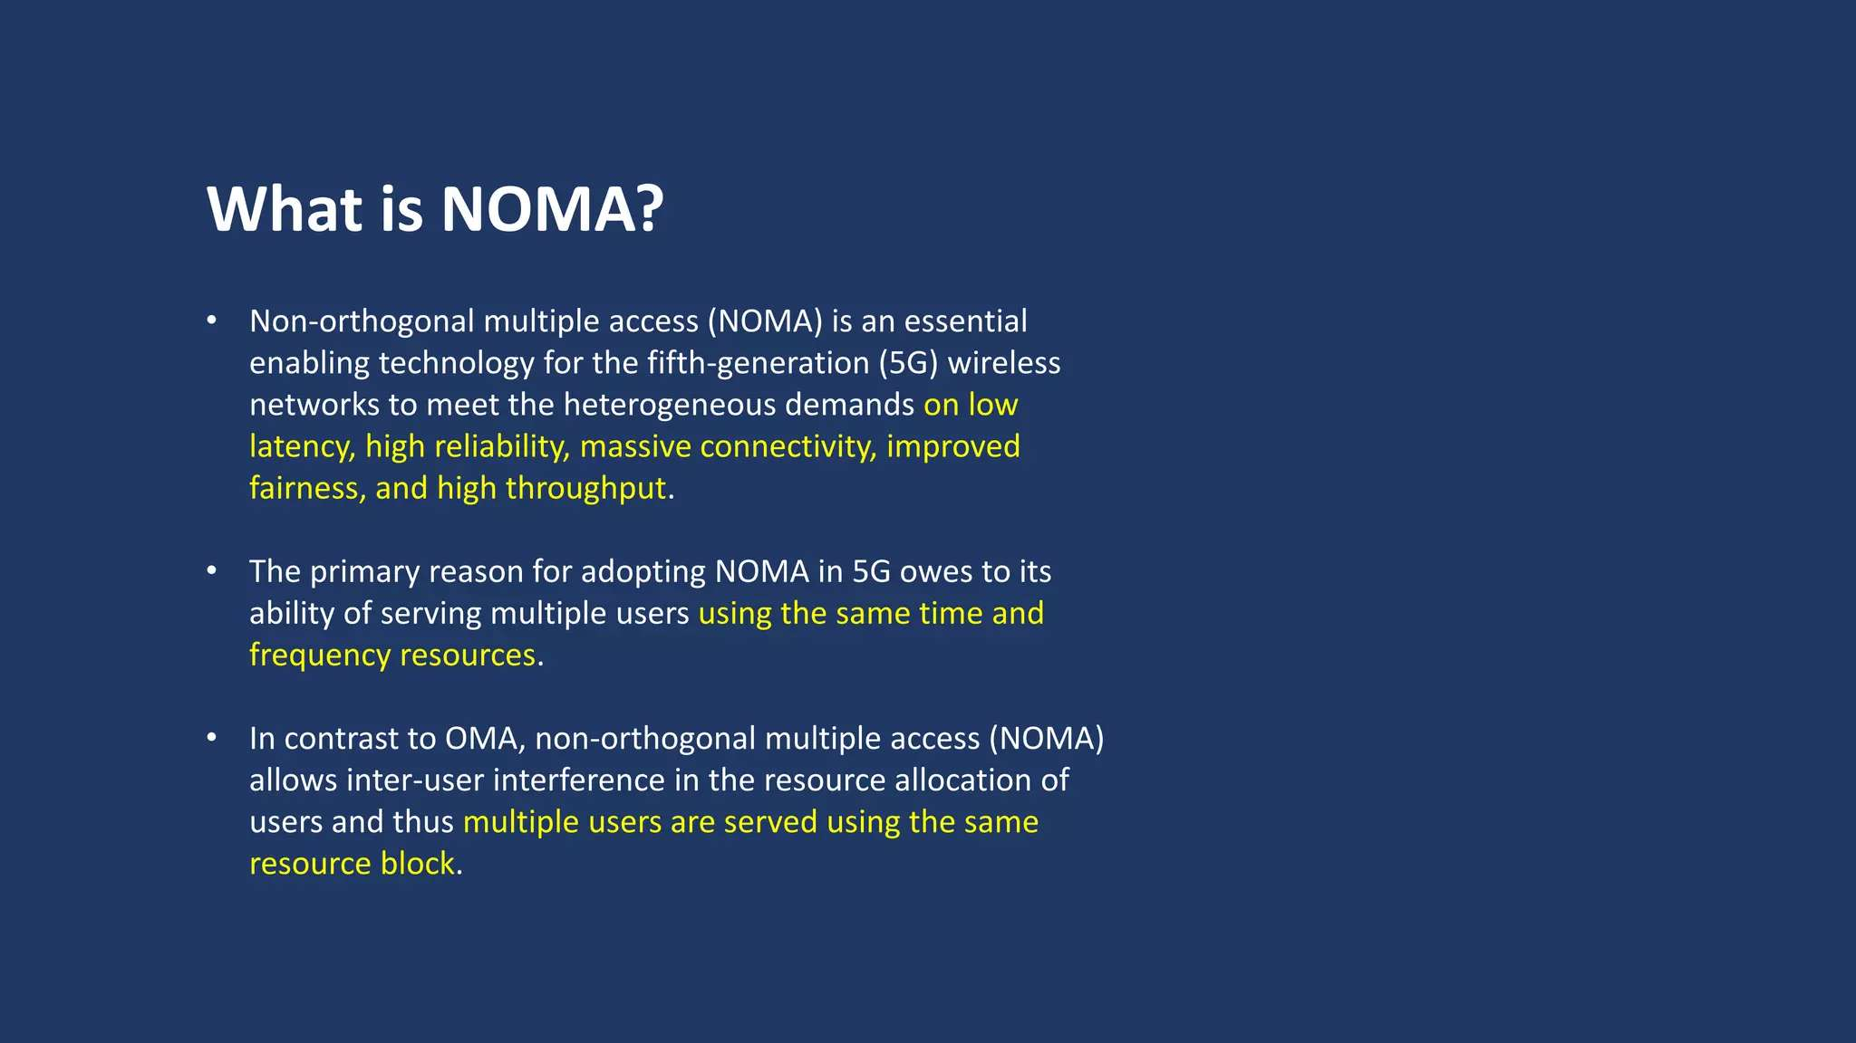

Slide 14
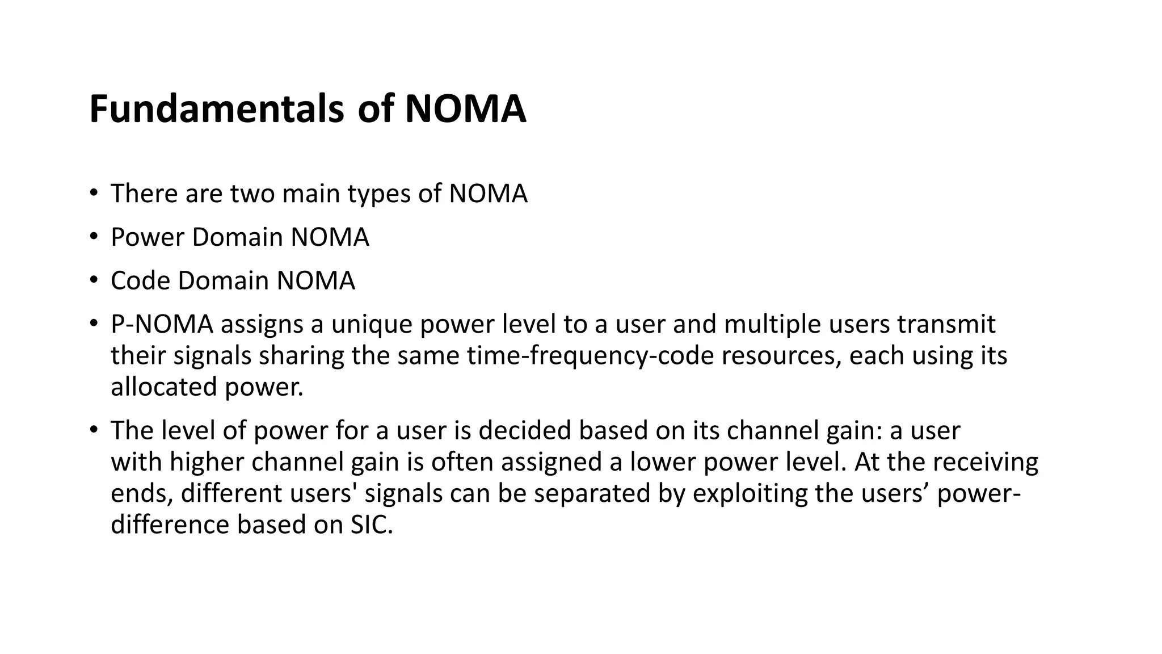

Slide 15
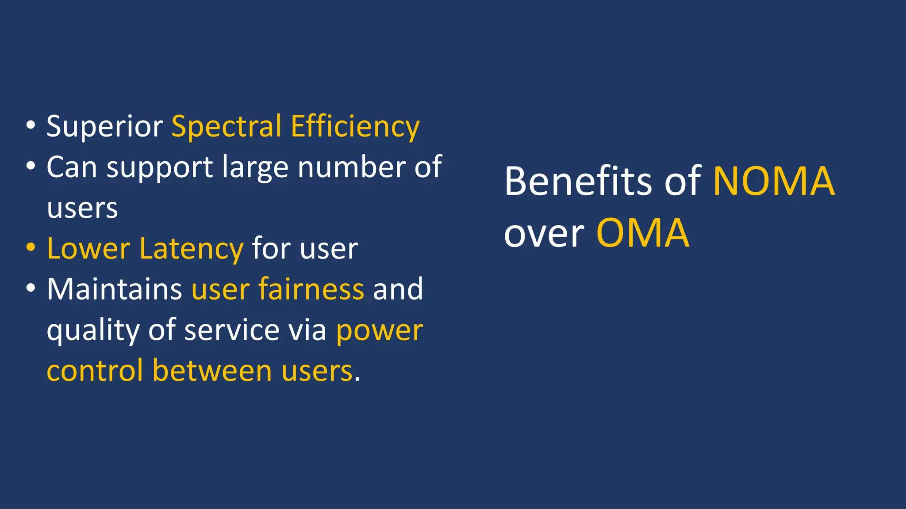

Slide 16
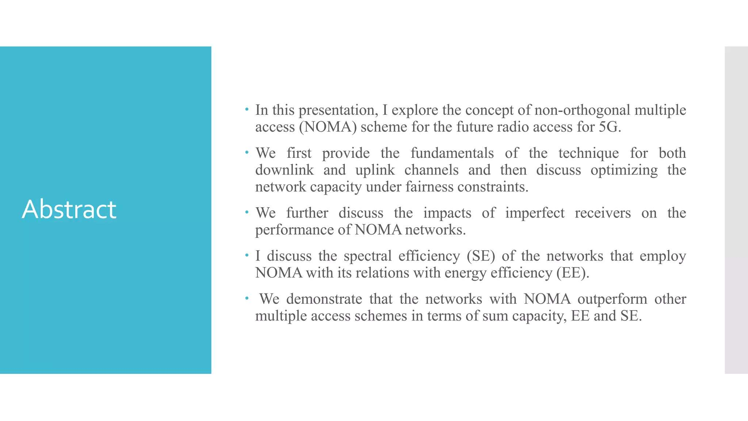

Slide 17
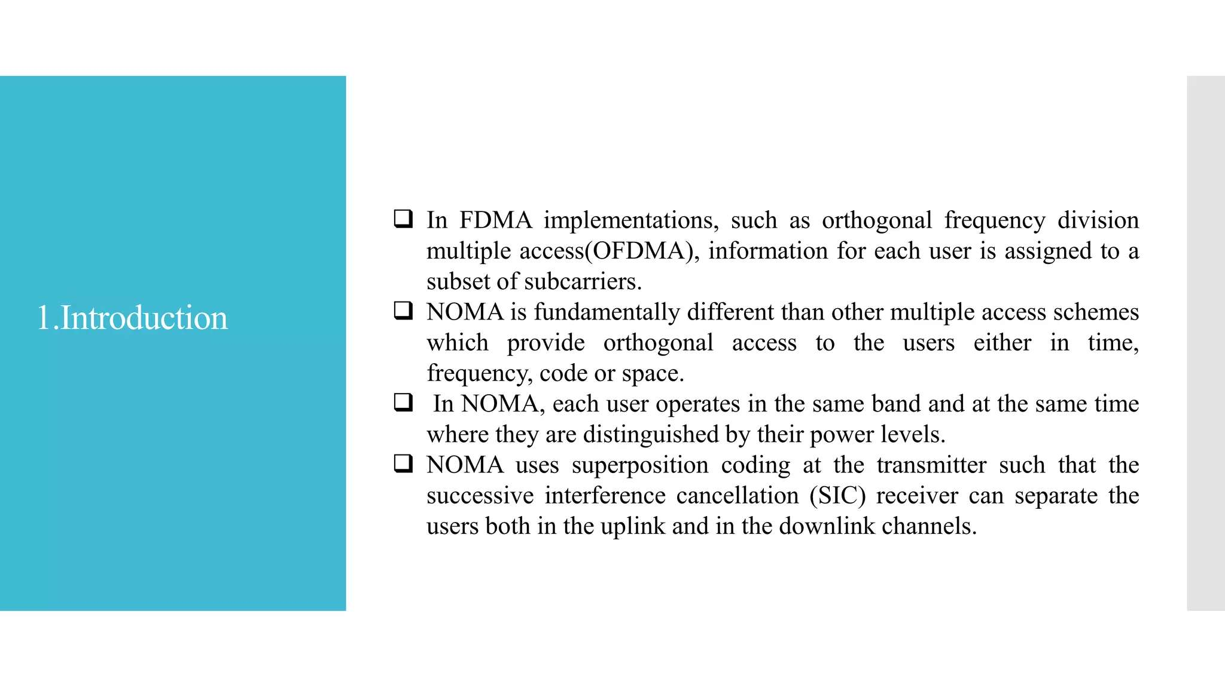

Slide 18
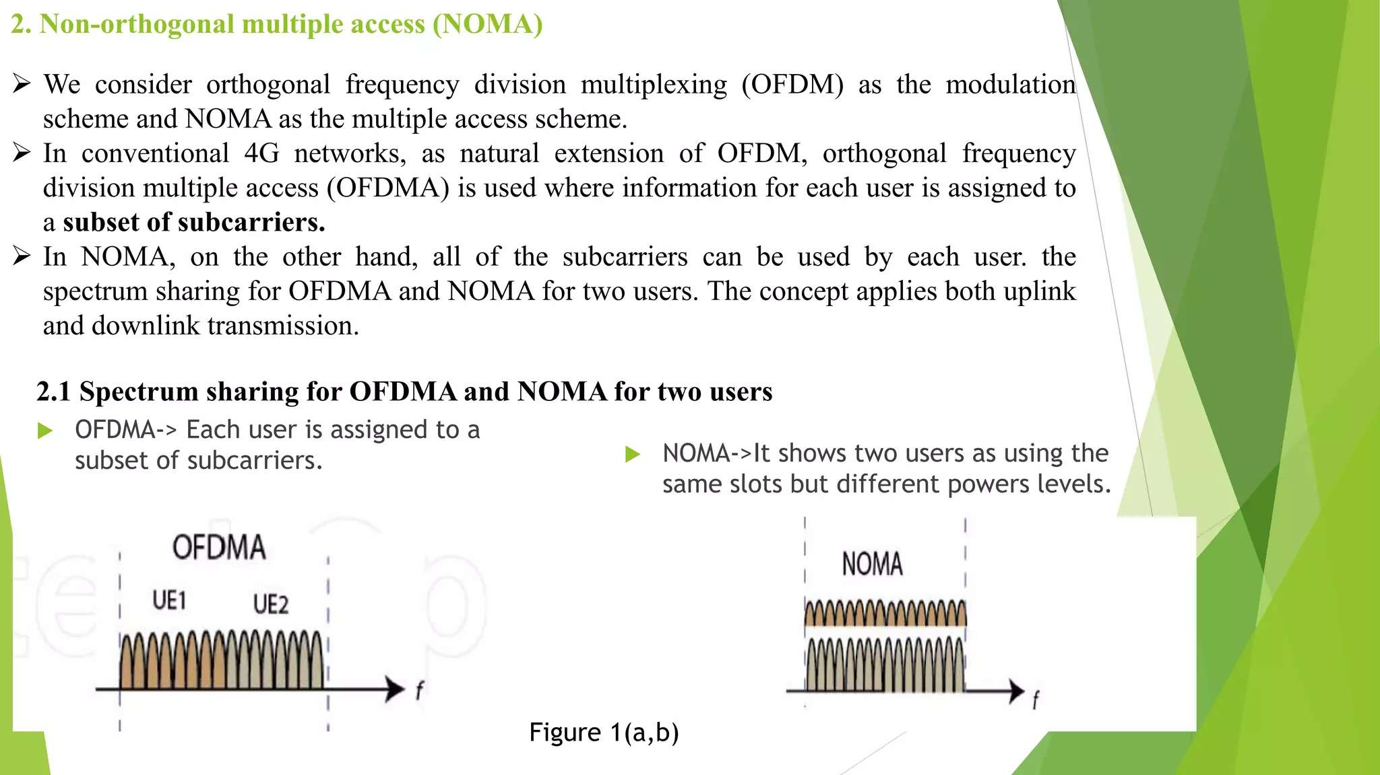

Slide 19
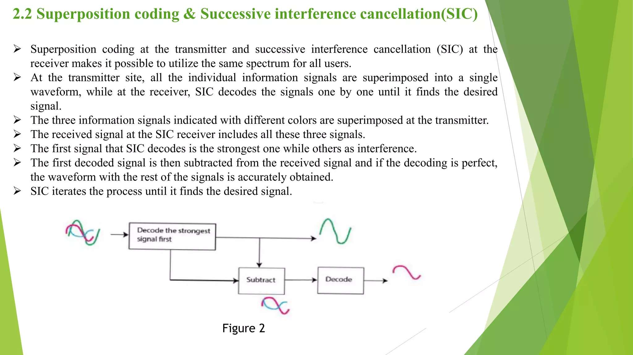

Slide 20
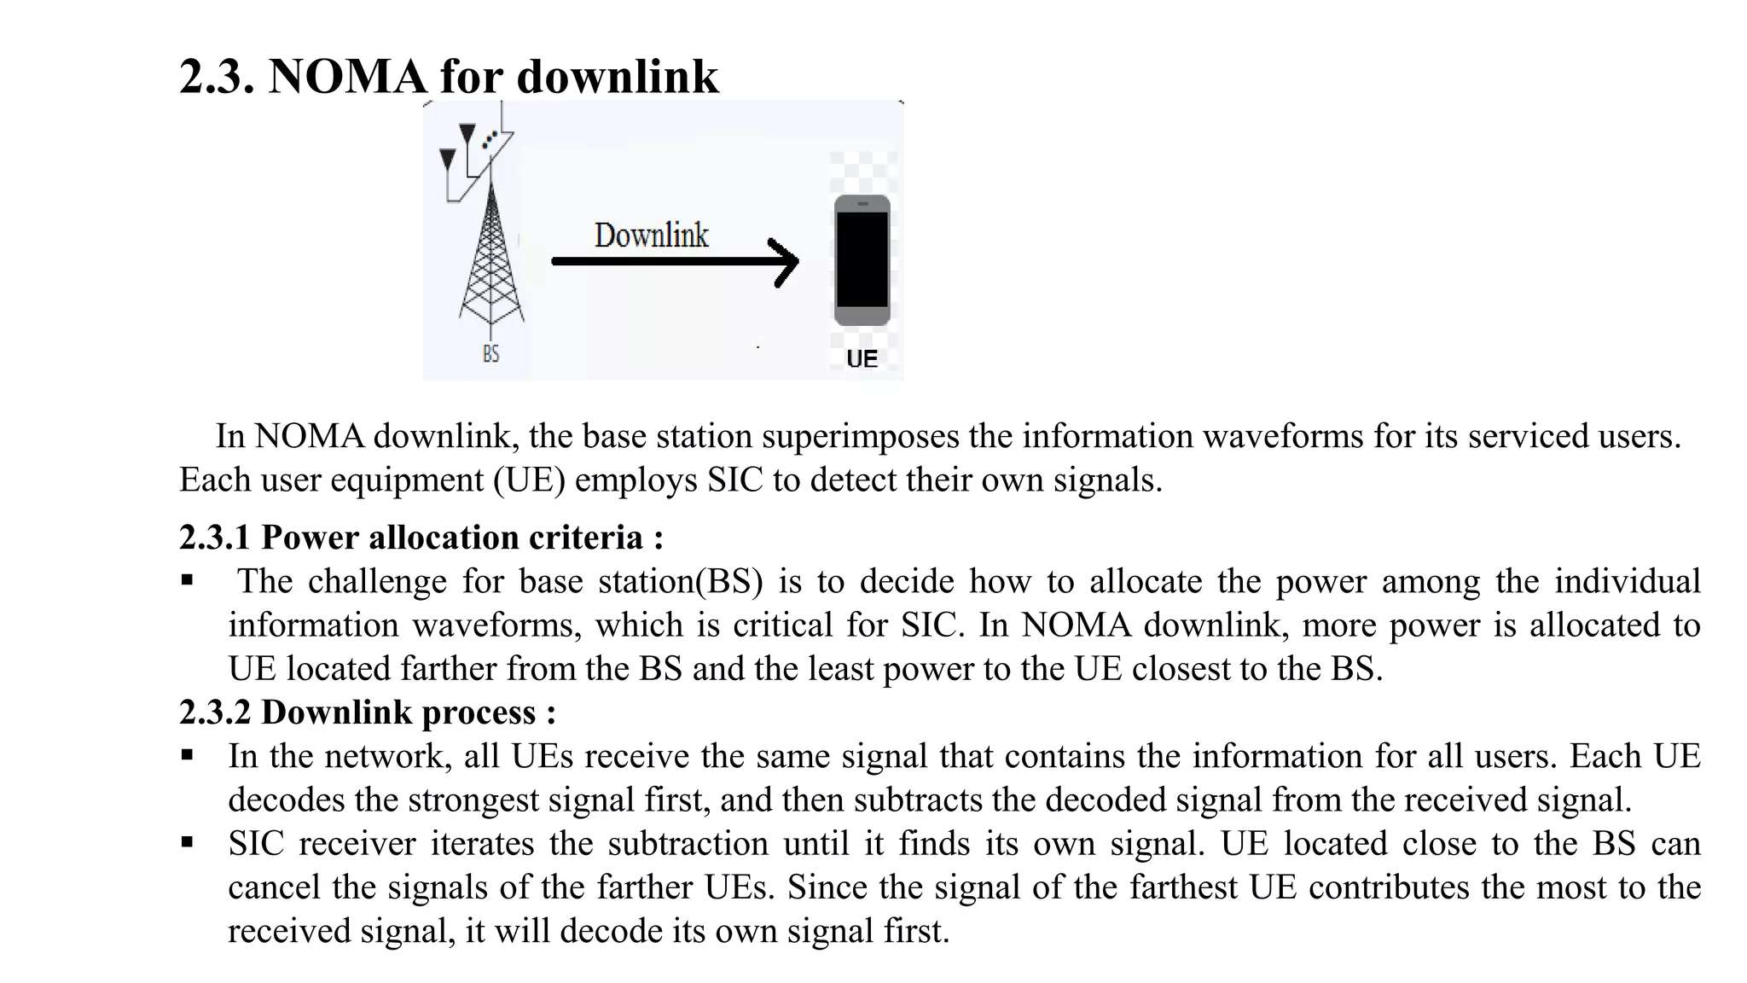

Slide 21
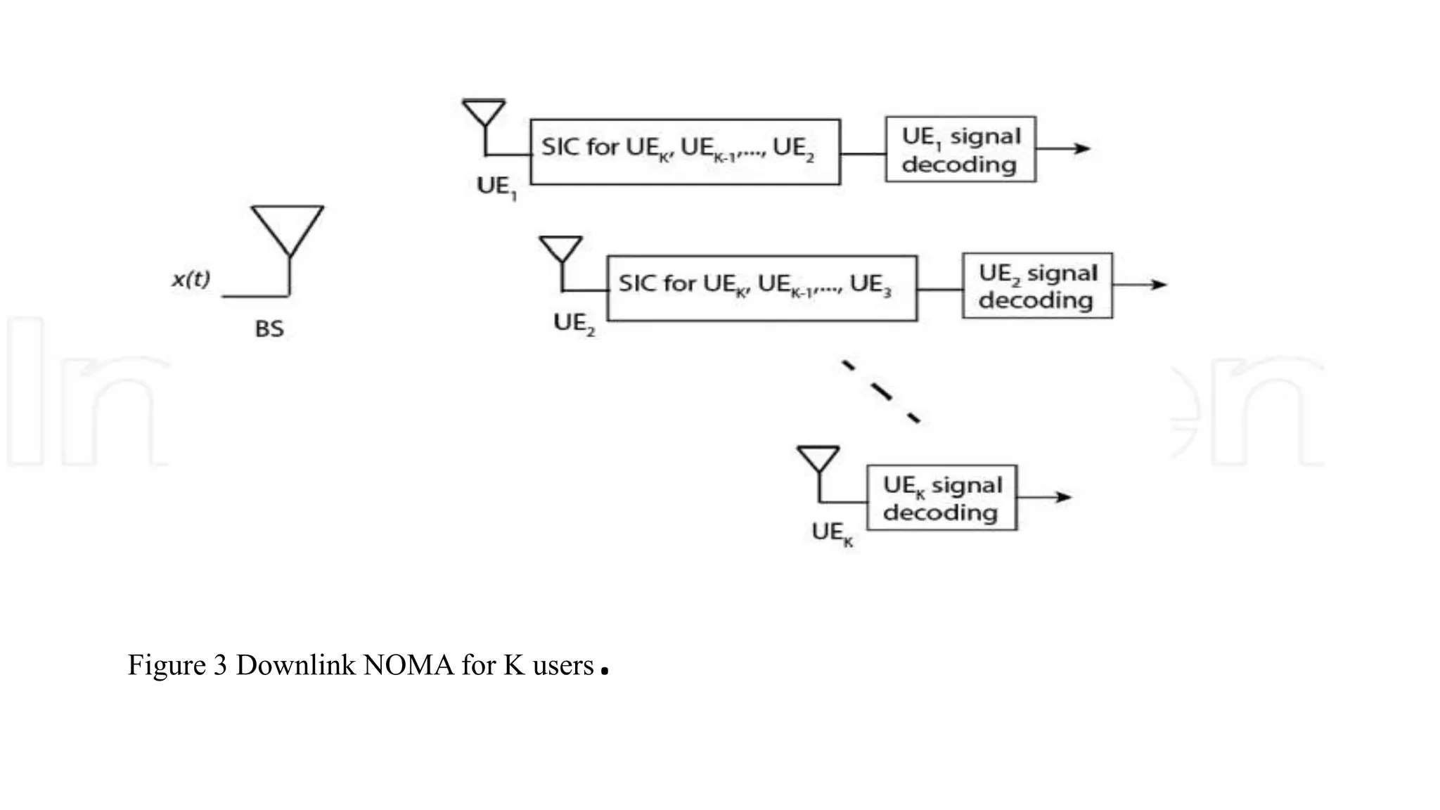

Slide 22
AGENDA
Why NOMA in 5G
CR_NOMA in 5G simulation
CR_NOMA in 5G use cases
Review of Paper ‘Energy Efficiency Optimization for NOMA-Based Cognitive Radio With Energy Harvesting’
Case Study of ‘CR_NOMA in 5G’ use cases in SMART AUTONOMOUS VEHICLE

Slide 23
Why NOMA in 5G ??
5G NOMA use Cases in SMART VEHICLES for
Handling BIG DATA in Autonomous Vehicles

Slide 24
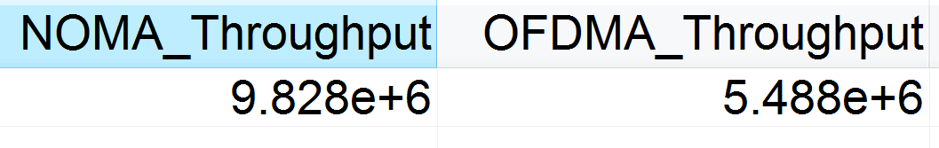
4G NOMA (Non-orthogonal multiple access) and 4G OFDMA (orthogonal multiple access OMA) Throughput
MULTIPLE USER RADIO ACEES (MA) OMA Vs NOMA :-
Present uses for 4G Multi user Radio Access ( MA) Technology : OMA
Future Uses for 5G MA … NOMA
OFDMA uses in present 4G SMART PHONE RADIO TECHNOLOGY
5G NOMA targeted for Big Data in Automotives
** Under Same Channel condition,
LTE NOMA throughput is almost Double than LTE OFDMA based OMA

Slide 25
5G NOMA
Non-orthogonal multiple access (NOMA) is one of the most promising radio access techniques in next-generation wireless communications. Compared to orthogonal frequency division multiple access (OFDMA), which is the current de facto standard orthogonal multiple access (OMA) technique, NOMA offers a set of desirable potential benefits, such as enhanced spectrum efficiency, reduced latency with high reliability, and massive connectivity. The baseline idea of NOMA is to serve multiple users using the same resource in terms of time, frequency, and space.
Two major categories
i) power-domain NOMA and
ii) code-domain NOMA.
Use Cases of 5G NOMA:- has the potential to be applied in various fifth generation (5G) communication scenarios, including Machine-to-Machine (M2M) communications and the Internet-of-Things (IoT).
TECHNICAL ISSUES with NOMA :- Since the principle of NOMA allows multiple users to be superimposed on the same resource, this leads to interference for such systems.
Solution for Interference Rejection from NOMA Receiver :-
NOMA adopts the principle of successive interference cancellation (SIC) algorithm at the receiver’

Slide 26
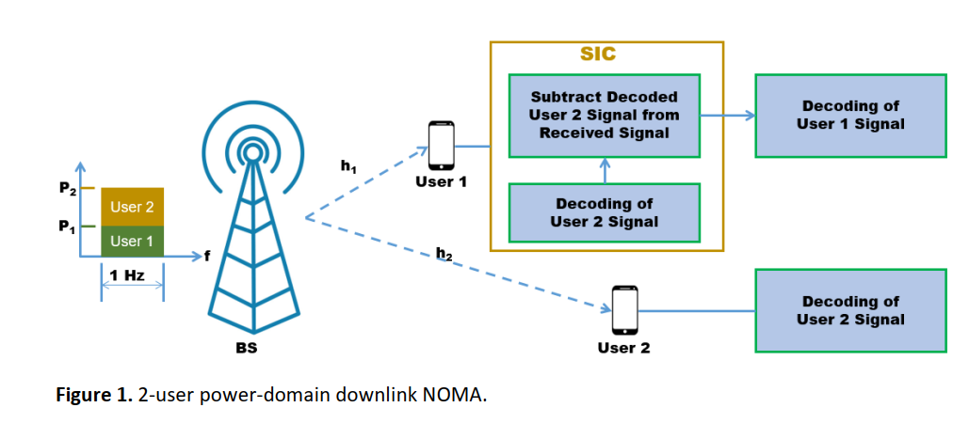
Power-Domain Downlink NOMA with One 5G Base Station and Two Users
SIC is a DIFFERENTIAL RECEIVER TECHNIQUE similar to OP-AMP ( Operational Amplifier) for
Rejecting Interference from Other Users using CMRR ( Common Mode Rejection Ratio)
of Similar Common Signal
Amplifying The differential signals

Slide 27
comparison-of-amplification-by- CE amplifier-and-an-op-amp
What are the differences in working of a common emitter amplifier and an op-amp? They both contain transistors, so what causes the difference and what are the differences?
ANS:- An opamp is a differential amplifier. That is, it amplifies the difference between its two inputs. An ideal opamp has the following characteristics of interest:
Infinite voltage gain for Difference Voltages at the Two Inputs
CMRR .. COMMON MODE Rejection ratio i.e. if two same DC voltages of 1 volt are fed at its input , its output voltahes will be ZERO
A common emitter amplifier is a very simple single-transistor amplifier.
It's single-ended, rather than differential: it amplifies a voltage with reference to ground.

Slide 28
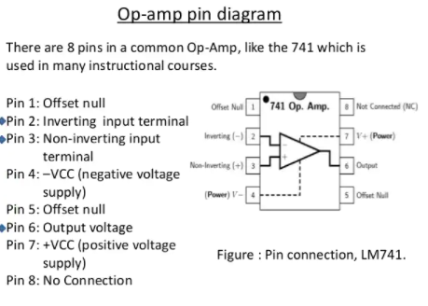

Slide 29
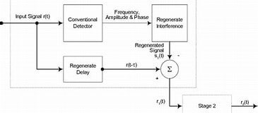
SIC
Successive Interference Cancellation (SIC) is a technique used by a receiver in a wireless data transmission that allows decoding of two or more packets that arrived simultaneously (in a regular system, more packets arriving at the same time cause a collision).

Slide 30
AGENDA
Why CR_NOMA in 5G
NOMA in 5G simulation
CR_NOMA in 5G use cases
Review of Paper ‘Energy Efficiency Optimization for NOMA-Based Cognitive Radio With Energy Harvesting’
Case Study of ‘CR_NOMA in 5G’ use cases in SMART AUTONOMOUS VEHICLE

Slide 31
5G NOMA Simulation in Systemvue software

Slide 32
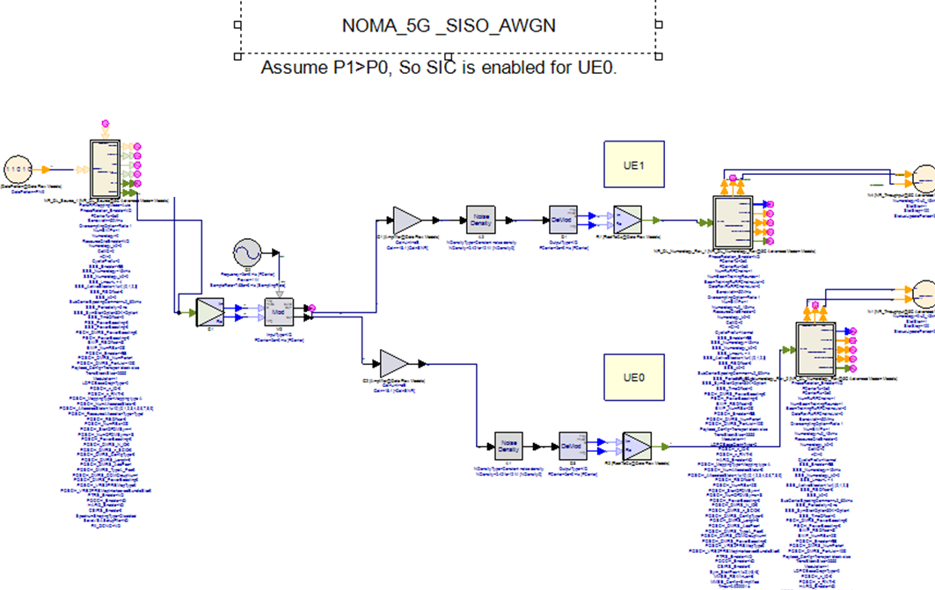
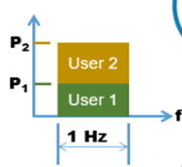
5G BASE STATION
UE 1 with SIC

Slide 33
5G_NOMA Throughput
This example workspace demonstrates NOMA (Non-Orthogonal Multiple Access) access link-level performance with 2 UEs for 5G downlink SISO system in AWGN environment. In NOMA access scheme, different UES are transmitted on the same frequency with different power. In the receiver, for the UE with higher power, it just demodulate the signal regardless of the signal of lower power UE. For the UE with lower power, firstly it needs to demodulate the signal of higher power UE using SIC (successive interference cancellation) method, then demodulate its own signal.
In the design “NOMA_5G_Design”, the input parameters includes
1. Bandwidth: the bandwidth of 5G signal
2. SINR0 and SINR0: the ratio of signal to interference and noise for UE0 and UE1. SINR0 should be larger than SINR1 in this simulation, and the difference should be larger enough in order to have SIC work properly.
In the design “NOMA_5G_Design”, FTPA (Fractional Transmit Power Allocation) method is used to determine the power allocation among two users given the SINRs. And MCS for each UE is selected according to SINR and MCS table. With the default, all RB resources are allocated to these two UEs.
In the design "NOMA_5G _Design", NOMA source and receiver are created based on 5G.
Subnet "NOMA_5G_DL_Src" shows the new NOMA source, a new UE is added with channel coding and constellation mapping, then the constellations of new UE and exised UE are superposed with different power.
Subnet "NOMA_5G_DL_Rrc" shows the new NOMA receiver, a new SIC procedure is added after layer demapper and deprecoder. For the high power UE, the SIC is bypassed, for the low power UE, SIC can help remove the interference from high power UE.

Slide 34
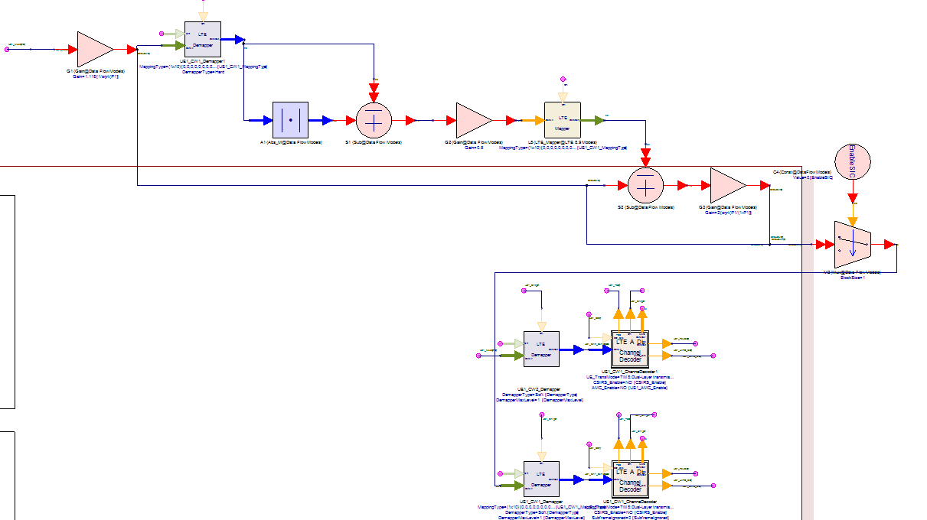
SIC (successive Interference cancellation) part of the Receiver
SIC realized using A Differential Receiver
Receiver 1 … Normal receiver
Receiver 2 … Differential receiver

Slide 35
AGENDA
Why CR_NOMA in 5G
CR_NOMA in 5G simulation
NOMA in 5G use cases
Review of Paper ‘Energy Efficiency Optimization for NOMA-Based Cognitive Radio With Energy Harvesting’
Case Study of ‘CR_NOMA in 5G’ use cases in SMART AUTONOMOUS VEHICLE

Slide 36
5G NOMA use CASES
5G NOMA in 5G Vehicular Communication
5G NOMA in 5G for SMART HOME 1
5G-NOMA in 5G for SMART Home 2

Slide 37
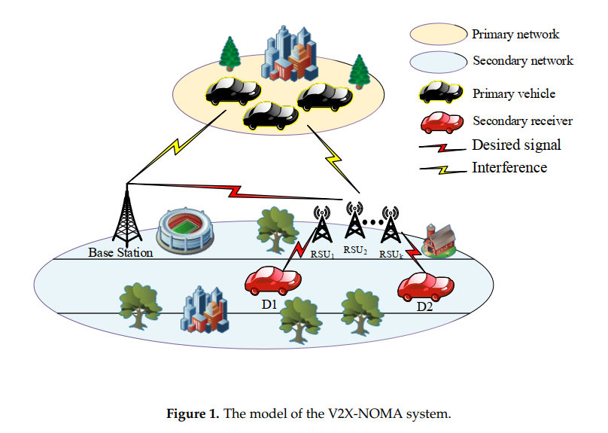

Slide 38
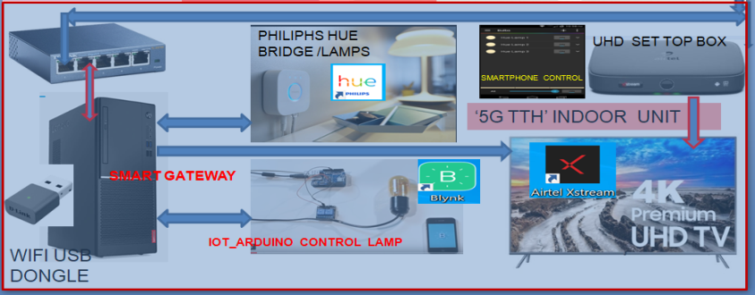
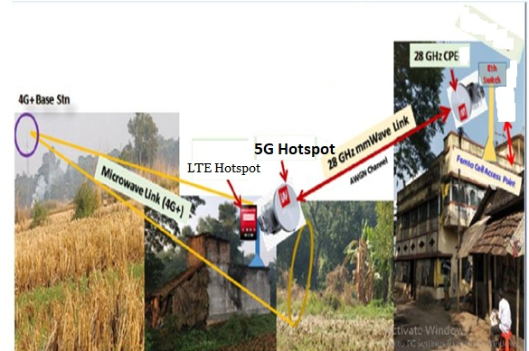
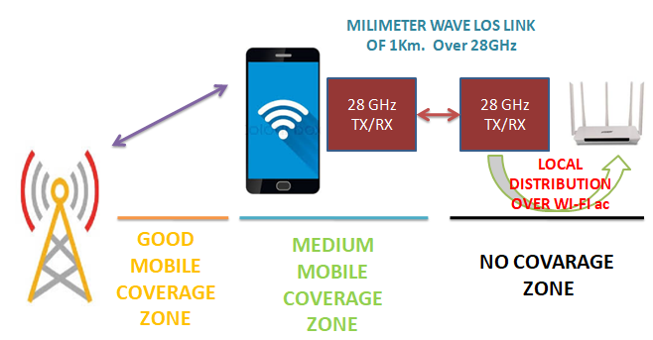
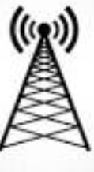
Fig. 1(a) :- 5G NSA ARCHITECTURE
‘5G TTH … WIRELESS CONNECTIVITY ’ TO SMART HOME using ‘5G Hotspot’ and ‘5G CPE’ mmWave with NSA ( Non StandAlone) modes of Operation
Fig 1(b) :- 5G NOMA (Connect the unconnected REMOTE HOME ) following NSA ARCHITECTURE

Slide 39
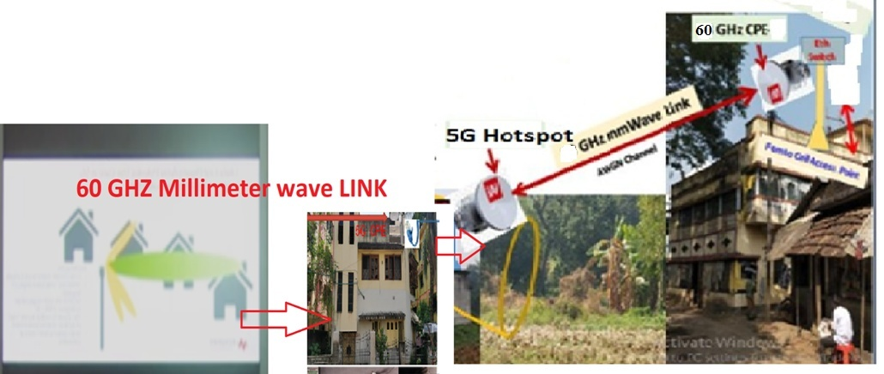
Fig 4: The FTTH extension with Two Milliemeter wave radio Link towards solutions related to Road Crossing and Long distant Extension to FTTH to a remote second Home
REMOTE HOME 2
LOCAL HOME 1

Slide 40
AGENDA
Why CR_NOMA in 5G
CR_NOMA in 5G simulation
CR_NOMA in 5G use cases
Review of Paper ‘Energy Efficiency Optimization for NOMA-Based Cognitive Radio With Energy Harvesting’
Case Study of ‘CR_NOMA in 5G’ use cases in SMART AUTONOMOUS VEHICLE

Slide 41
X. Wang et al., "Energy Efficiency Optimization for NOMA-Based Cognitive Radio With Energy Harvesting," in IEEE Access, vol. 7, pp. 139172-139180, 2019, doi: 10.1109/ACCESS.2019.2940698.
Abstract: Energy Efficiency (EE) is a significant problem for Cognitive Radio (CR) network. Recently, more interest has focused on EE optimization problem in wireless-powered communication. In conventional CR network, spectrum sensing and limited battery capacity may decrease system performance. In this article, a Non-Orthogonal Multiple Access (NOMA) system with Simultaneous Wireless Information and Power Transfer (SWIPT) for CR network is studied. The frame structure is designed with two subslots. In the downlink subslot, the Secondary Users (SUs) harvest wireless energy from Radio Frequency (RF) signals and sense the spectrum state simultaneously. In the uplink subslot, SUs transmit their independent information to Base Station (BS). Two modes are considered in this article: overlay network and underlay network. A CR-NOMA system model is presented and the approximate expressions of EE for two modes are obtained. Based on the subslot allocation, two optimization problems aiming to maximize EE are formulated. In the overlay network, the constraints are transmit power and total transmission slot. In the underlay network, instead of sensing the spectrum, SUs utilize the channel with primary user (PU) simultaneously. Thus, the constraints of interference threshold and channel gain of PU are also taken into considered. The proposed optimization problems can be regarded as nonlinear fractional programming. The Dinkelbach method is used to transform the nonlinear fractional programming problems into the parametric ones. Simulation results show that there indeed exists a best downlink subslot to maximize the EE of CR-NOMA networks.
URL: https://ieeexplore.ieee.org/stamp/stamp.jsp?tp=&arnumber=8835017&isnumber=8600701

Slide 42
I. INTRODUCTION
Cognitive Radio (CR) can effectively alleviate spectrum resource shortage by performing opportunistic spectrum access in time, frequency and airspace [1]–[5]. When the Primary User (PU) is absent, CR allows the Secondary Users (SUs) to access idle channel to improve the spectrum utilization. Since PU has the priority to use the licensed frequency band, the SUs must detect the licensed frequency band occupancy in real time via spectrum sensing [6], [7]. Energy detection is widely used to perform spectrum sensing currently because it is easily implemented and no PU’s prior information is required. However, sensing performance may suffer from the effects of hidden terminal problems [8], [9] such as shadow effect and multipath fading. Two main modes, i.e., overlay CR network and underlay CR network, have been widely studied in current researches. For the former, the SUs can utilize the frequency band released by PU so that the conflict with the PU’s information transmission can be avoided. For the latter, the SUs can utilize the frequency band with PU as long as the interference with PU is limited below a certain threshold

Slide 43
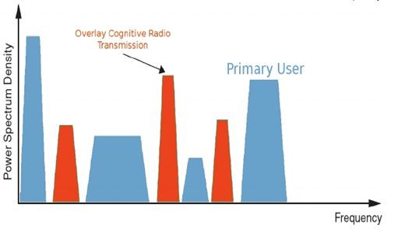
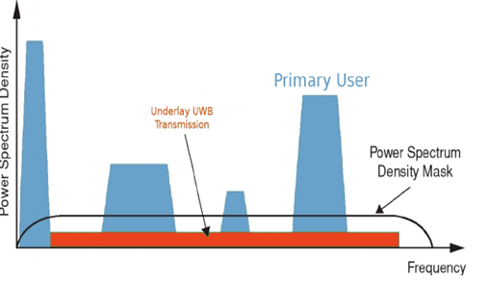
Overlay and Underlay spectrum in CR
OVERLAY SPECTRUM
UNDERLAY SPECTRUM using SS

Slide 44
Non-Orthogonal Multiple Access (NOMA) [10]–[13] is a promising wireless access technique for the coming 5G era. NOMA uses non-orthogonal transmission at the transmitter and users’ information is superposed in power domain for higher spectrum efficiency. Different from Orthogonal Multiple Access (OMA), NOMA can serve multiple terminals over the same resource block, thus it can effectively enhance sum rate. Successive Interference Cancellation (SIC) is adopted to decode the users’ information at the receiver. Specifically, the user with the best channel condition is decoded firstly, while other users are regarded as interference. Reference [14] gave the review on NOMA and compared OFDMA and NOMA. Specifically, OFDMA is applied to Long Term Evolution (LTE) radio access scheme, while NOMA is applied to 5G communication system. NOMA can improve Spectrum Efficiency (SE) due to non-orthogonal transmission and SIC, thus the application of NOMA to CR secondary network is necessary to improve the SE in CR network. Reference [15] designed a CR-NOMA model and an SE optimization problem was solved by optimizing the sensing subslot. Since CR-NOMA combines the advantages of both the techniques, it is considered as a promising technique for the coming 5G communication system [16], [17].

Slide 45
Recently, Simultaneous Wireless Information and Power Transfer (SWIPT) [18]–[21] has been regarded as a promising solution to energy-limited wireless communication networks. From the perspective of information and energy transmission, SWIPT can effectively balance information transmission in the uplink and energy harvesting in the downlink. Thus, there are numerous research efforts to the optimization of uplink and downlink transmission subslot allocation in most existing literature. Actually, Radio Frequency (RF) signals at the receiver can be divided into two streams: one stream is used to harvest energy, while the other one is used to transmit information [22]. However, due to the practical circuit limitation, it is not realizable to perform energy harvesting and information decoding simultaneously at the receiver. In order to deal with the problem, Power Splitting (PS) and Time Switching (TS) mode were proposed [23]. The harvested energy can be used for information transmission and circuit power consumption so that the lifetime of wireless devices can be prolonged.

Slide 46
II. SYSTEM MODEL
OVERLAY CR NETWORK
In this section, a SWIPT based CR-NOMA system model consisting of one BS, one PU and N SUs is proposed as shown in Fig. 1. The notation of necessary parameters is listed in Table 1. In the proposed model, PU and SUs harvest energy first, then transmit independent information to BS. Furthermore, SUs perform spectrum sensing which may produce interference with PU’s information transmission. Fig. 2 shows the frame structure of the overlay CR-NOMA network. T is the duration of one frame which is called transmission slot and the frame is divided into two subslots: downlink subslot τ is used for spectrum sensing and SWIPT, while uplink subslot T - τ is used for transmitting SUs’ data. Here, SWIPT means that PU and SUs harvest energy and PU transmits its information simultaneously.

Slide 47
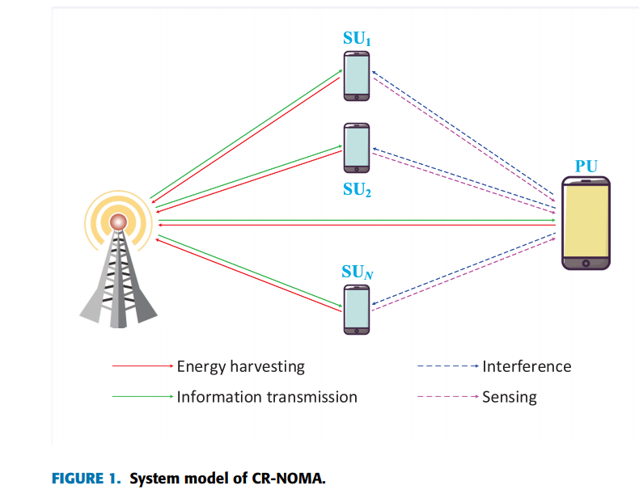
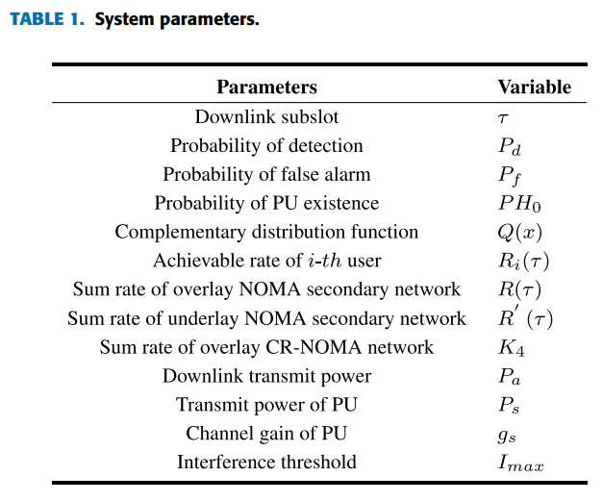

Slide 48
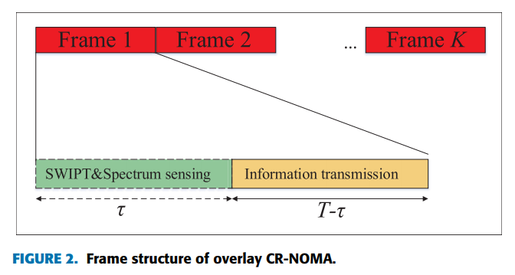
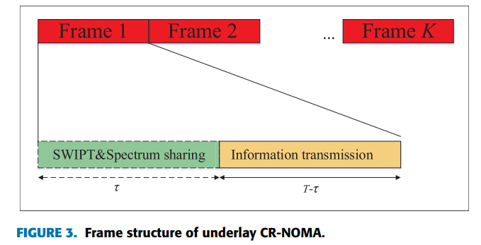

Slide 49
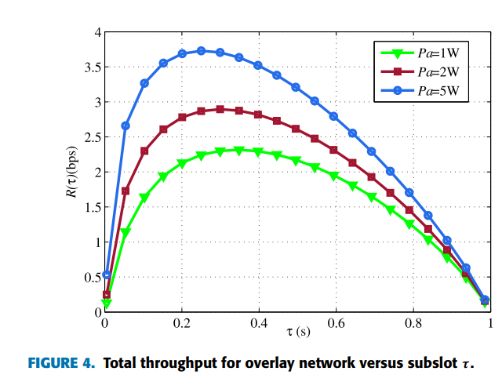
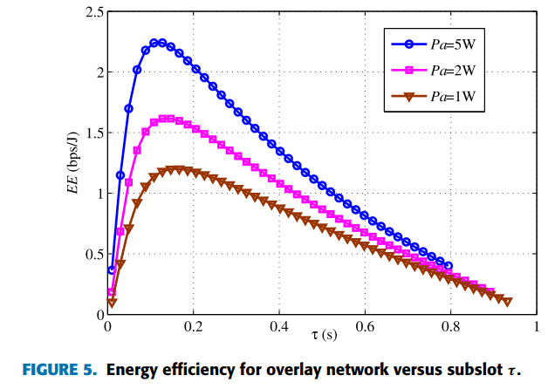

Slide 50
V. CONCLUSION
In this article, considering low spectrum utilization and limited battery capacity, a SWIPT based CR-NOMA system model is proposed, and the EE optimization is investigated. Wherein, two network modes are considered, i.e., overlay network and underlay network. Specifically, in the overlay mode, SUs perform spectrum sensing and SUs can transmit information only when PU is detected to be absent. In the underlay mode, SUs and PU can utilize the spectrum resource simultaneously as long as the interference is below a certain threshold. SWIPT is applied to achieve the best tradeoff between information transmission and lifetime of energylimited networks. Specifically, SUs harvest energy during the downlink subslot while transmitting information during the uplink subslot. In addition, NOMA is used to transmit information for the secondary CR network. EE is optimized under the constraints of total transmit power, total transmission slot, interference threshold and channel gain of PU. Then, an iterative algorithm based on the Dinkelbach method is proposed to solve the optimization problems. Simulation results show that the proposed SWIPT based CR-NOMA model can achieve a tradeoff between EE and downlink subslot. Considering that NOMA is an evolution of OFDMA rather than a revolution, thus the signal on the subchannel is still an OFDM signal. The resource allocation of OFDM-NOMA system will be studied in the future work. Moreover, for the poor channel performance of direct transmission link, the resource allocation of SWIPT based CR-NOMA cooperative relay system will be studied in the future work.

Slide 51
AGENDA
Why CR_NOMA in 5G
CR_NOMA in 5G simulation
CR_NOMA in 5G use cases
Review of Paper ‘Energy Efficiency Optimization for NOMA-Based Cognitive Radio With Energy Harvesting’
Case Study of ‘CR_NOMA in 5G’ use cases in ‘V2X CR-NOMA’ used in AUTONOMOUS VEHICLE

Slide 52
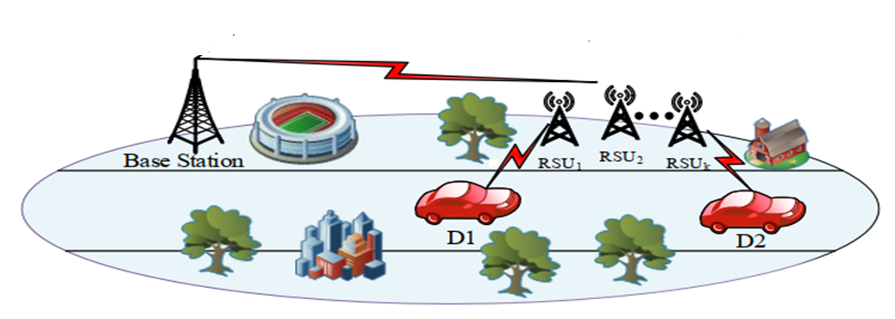
D2 Vehicle … Govt. Vehicles as Primary User
D1 Vehicle …..Other Vehicles as Secondary User
System Model of V2X CR-NOMA

Slide 53
Salient Features of V2X CR-NOMA
ASSUMPTIONS
Day Time _Office Hours..
Both PU and SU will be use Radio Charging based Energy Hervaseting in the 1st Slot of the Radio Frame
Activities in 2nd Slot :-
PU is present and SU will use UNDERLAY Mode or SU will not Transmit in 2nd Slot of the Radio Frame
Night Time NON-OFFICE Hour
Both PU and SU will be use Radio Charging based Energy Hervaseting in the 1st Slot of the Radio Frame
Activities in 2nd Slot :-
PU is mostly absent and SU will use OverLAY Mode for its transmission as PU presence is Occasional
Additionally, if SU will sense the environment for the presence of PU vehicles

Slide 54
Radio Charging based Energy Hervasting Methods used in Passive RFID Tags

Slide 55
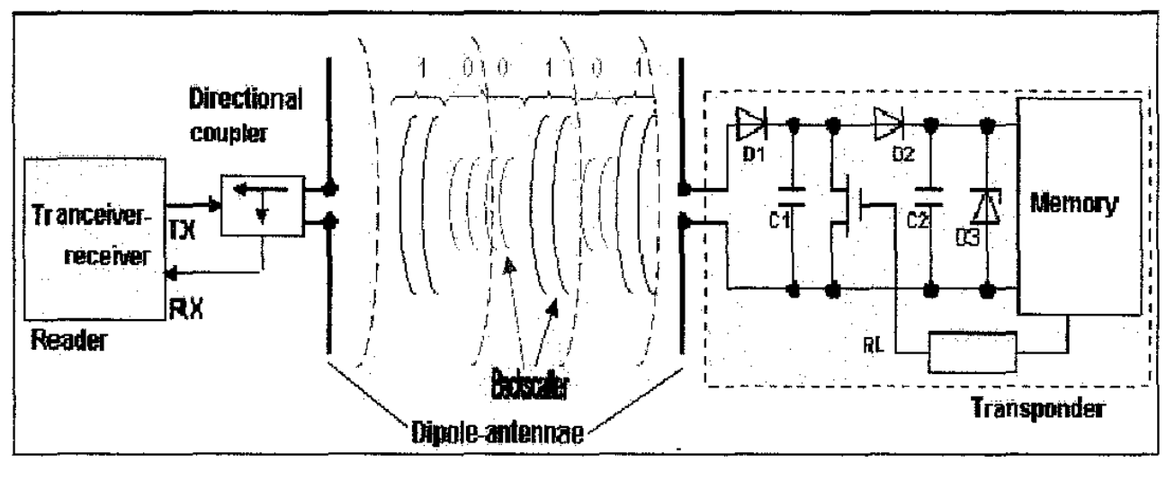
Simplified Model of RFID_ Reader and RFID_Tag
RFID_READER
RFID_TAG

Slide 56
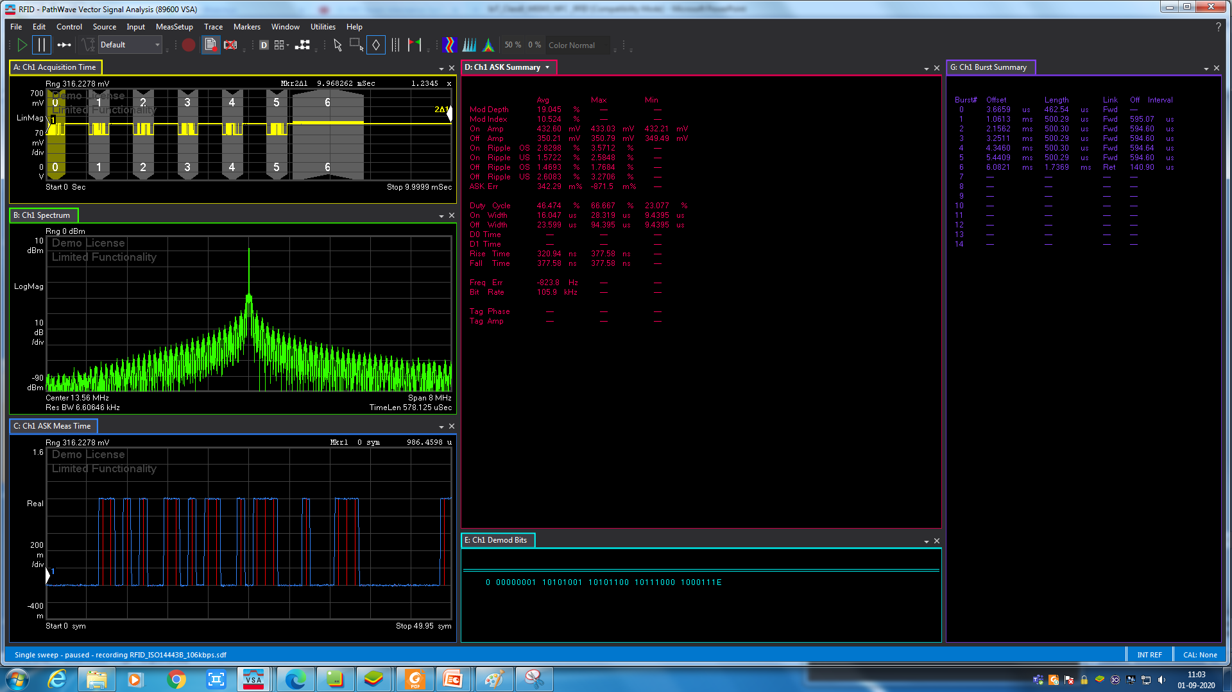
CW signal [ Trace A] Total Time Duration = 8.86 msec
BURST signal [ Trace A and Trace C [ ZOOMED]
RF Spectrum at 13.56 MHz [ TRACE B]
ASK [ DSB_ASK} Summary [ Trace D]
DEMOD Bits _BURST 0_ Forward Direction [ Trace E]

Slide 57
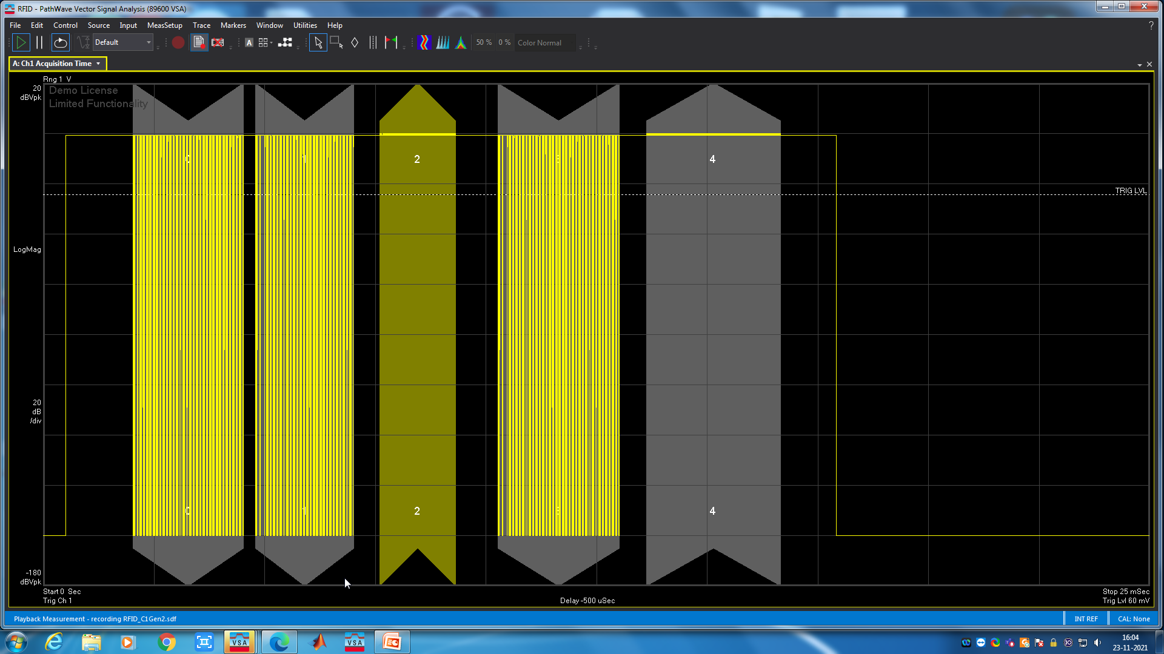
Time Slot 1 and 3 used for Information Transfer from RFID READER to TAG
Time Slot 2 and 4 used for Information Transfer (IT) from RFID TAG from RFID READER
CW signal Total Time Duration = 8.86 msec for Power Transfer (PT) to TAG from RFID READER
SWIPT ( Simultaneous Wireless Information and Power Transfer) is already operational in RFID Tags

Slide 58
AGENDA
Why CR_NOMA in 5G
CR_NOMA in 5G simulation
CR_NOMA in 5G use cases
Review of Paper ‘Energy Efficiency Optimization for NOMA-Based Cognitive Radio With Energy Harvesting’
Case Study of ‘CR_NOMA in 5G’ use cases in SMART AUTONOMOUS VEHICLE
Review the Book :- ‘ Wireless Information and Power Transfer: Theory and Practice’ By IEEE and Wiley

Slide 59
How to Use the same SWIPT Technology in Electric Vehicle charging ?
Review the Book :-
Wireless Information and Power Transfer: Theory and Practice
By IEEE and Wiley

Slide 60
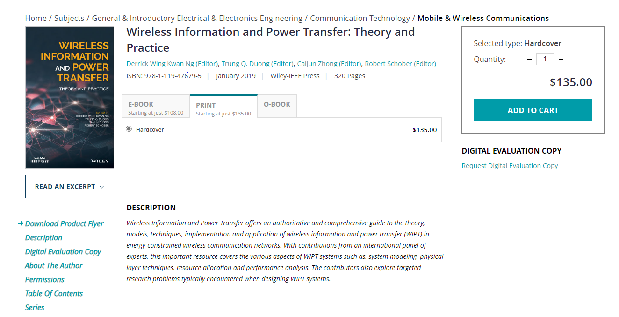

Slide 61
vii
Contents
List of Contributors xiii
Preface xvii
The Era of Wireless Information and Power Transfer 1
Derrick Wing Kwan Ng, Trung Q. Duong, Caijun Zhong, and Robert Schober
Introduction 1
Background 3
RF-Based Wireless Power Transfer 3
Receiver Structure for WIPT 4
Energy Harvesting Model and Waveform Design 6
1
COPYRIGHTED MATERIAL
Eﬃciency and Interference Management in WIPT Systems 9
Security in SWIPT Systems 10 Cooperative WIPT Systems 11 WIPT for 5G Applications 11 Conclusion 12
Acknowledgement 13
Bibliography 13
Fundamentals of Signal Design for WPT and SWIPT 17
Bruno Clerckx and Morteza Varasteh
Introduction 17
WPT Architecture 19
WPT Signal and System Design 21 SWIPT Signal and System Design 29 Conclusions and Observations 33 Bibliography 33
Uniﬁed Design of Wireless Information and Power Transmission 39
Dong In Kim, Jong Jin Park, Jong Ho Moon, and Kang Yoon Lee
Introduction 39
Nonlinear EH Models 40
2
2.1
2.2
2.3
2.4
2.5
3
3.1
3.2

Slide 62
viii
Contents
Waveform and Transceiver Design 43
Multi-tone (PAPR) based SWIPT 43
Dual Mode SWIPT 48
Energy Harvesting Circuit Design 53
Discussion and Conclusion 58
Bibliography 58
Industrial SWIPT: Backscatter Radio and RFIDs 61
Panos N. Alevizos and Aggelos Bletsas
Introduction 61
Wireless Signal Model 62
RFID Tag Operation 64
RF Harvesting and Powering for RFID Tag 64
RFID Tag Backscatter (Uplink) Radio 65
Reader BER for Operational RFID 68
RFID Reader SWIPT Reception 69
Harvesting Sensitivity Outage 69
Power Consumption Outage 70
Information Outage 71
Successful SWIPT Reception 71
Numerical Results 72
Conclusion 76
Bibliography 76
Multi-antenna Energy Beamforming for SWIPT 81
Jie Xu and Rui Zhang
Introduction 81
System Model 84
Rate–Energy Region Characterization 87
Problem Formulation 87
Optimal Solution 90
Extensions 93
Conclusion 94
Bibliography 95
On the Application of SWIPT in NOMA Networks 99
Yuanwei Liu and Maged Elkashlan
Introduction 99
Motivation 100
Network Model 101
Phase 1: Direct Transmission 101
Phase 2: Cooperative Transmission 104
Non-Orthogonal Multiple Access with User Selection 105
4
5
6

Slide 63
Contents ix
RNRF Selection Scheme 105
NNNF Selection Scheme 108
NNFF Selection Scheme 111
Numerical Results 112
Outage Probability of the Near Users 112
Outage Probability of the Far Users 115
Throughput in Delay-Sensitive Transmission Mode 116
Conclusions 117
Bibliography 118
Fairness-Aware Wireless Powered Communications with Processing Cost 121
Zoran Hadzi-Velkov, Slavche Pejoski, and Nikola Zlatanov
Introduction 121
System Model 122
Energy Storage Strategies 124
Circuit Power Consumption 124
Proportionally Fair Resource Allocation 125
Short-term Energy Storage Strategy 125
Long-term Energy Storage Strategy 127
Practical Online Implementation 130
Numerical Results 131
Conclusion 133
Appendix 133
Proof of Theorem 7.2 133
Bibliography 136
Wireless Power Transfer in Millimeter Wave 139
Talha Ahmed Khan and Robert W. Heath Jr.
Introduction 139
System Model 141
Analytical Results 143
Key Insights 147
Conclusions 151
Appendix 153
Bibliography 154
Wireless Information and Power Transfer in Relaying Systems 157
P. D. Diamantoulakis, K. N. Pappi, and G. K. Karagiannidis
Introduction 157
Wireless-Powered Cooperative Networks with a Single Source–Destination Pair 158
7
8
8.1
8.2
8.3
8.4
8.5
8.6
9
9.1
9.2

Slide 64
x Contents
System Model and Outline 158
Wireless Energy Harvesting Relaying Protocols 159
Multiple Antennas at the Relay 161
Multiple Relays and Relay Selection Strategies 163
Power Allocation Strategies for Multiple Carriers 166
Wireless-Powered Cooperative Networks with Multiple Sources 168
System Model 168
Power Allocation Strategies 169
Multiple Relays and Relay Selection Strategies 173
Two-Way Relaying Networks 175
Future Research Challenges 176
Nonlinear Energy Harvesting Model and Hardware Impairments 176
NOMA-based Relaying 176
Large-Scale Networks 176
Cognitive Relaying 177
Bibliography 177
Harnessing Interference in SWIPT Systems 181
Stelios Timotheou, Gan Zheng, Christos Masouros, and Ioannis Krikidis
Introduction 181
System Model 183
Conventional Precoding Solution 184
Joint Precoding and Power Splitting with Constructive Interference 185
Problem Formulation 186
Upper Bounding SOCP Algorithm 188
Successive Linear Approximation Algorithm 190
Lower Bounding SOCP Formulation 191
Simulation Results 192
Conclusions 194
Bibliography 194
Physical Layer Security in SWIPT Systems with Nonlinear Energy Harvesting Circuits 197
Yuqing Su, Derrick Wing Kwan Ng, and Robert Schober
Introduction 197
Channel Model 200
Energy Harvesting Model 201
Channel State Information Model 203
Secrecy Rate 204
Optimization Problem and Solution 204
10
11

Slide 65
Contents xi
Results 208
Conclusions 211
Appendix-Proof of Theorem 11.1 211
Bibliography 213
Wireless-Powered Cooperative Networks with Energy Accumulation 217
Yifan Gu, He Chen, and Yonghui Li
Introduction 217
System Model 219
Energy Accumulation of Relay Battery 222
Transition Matrix of the MC 222
Stationary Distribution of the Relay Battery 224
Throughput Analysis 224
Numerical Results 226
Conclusion 228
Appendix 229
Bibliography 231
Spectral and Energy-Eﬃcient Wireless-Powered IoT Networks 233
Qingqing Wu, Wen Chen, and Guangchi Zhang
Introduction 233
System Model and Problem Formulation 235
System Model 235
T-WPCN and Problem Formulation 236
N-WPCN and Problem Formulation 237
T-WPCN or N-WPCN? 237
Optimal Solution for T-WPCN 238
Optimal Solution for N-WPCN 239
TDMA versus NOMA 240
Numerical Results 243
SE versus PB Transmit Power 243
SE versus Device Circuit Power 245
Conclusions 245
Future Work 247
Bibliography 247
Wireless-Powered Mobile Edge Computing Systems 253
Feng Wang, Jie Xu, Xin Wang, and Shuguang Cui
Introduction 253
System Model 256
Joint MEC-WPT Design 260
12
13
14

Slide 66
xii Contents
Problem Formulation 260
Optimal Solution 260
Numerical Results 266
Conclusion 268
Bibliography 268
Wireless Power Transfer: A Macroscopic Approach 273
Constantinos Psomas and Ioannis Krikidis
Wireless-Powered Cooperative Networks with Energy Storage 274
System Model 274
Relay Selection Schemes 276
Numerical Results 280
Wireless-Powered Ad Hoc Networks with SIC and SWIPT 282
System Model 282
SWIPT with SIC 284
Numerical Results 285
A Wireless-Powered Opportunistic Feedback Protocol 286
System Model 287
Wireless-Powered OBF Protocol 290
Beam Outage Probability 290
Numerical Results 292
Conclusion 293
Bibliography 294
Index 297
15

Slide 67
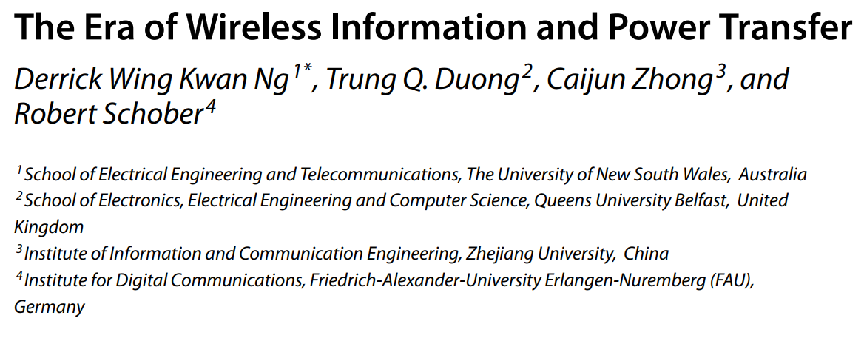
CHAPTER 1

Slide 68
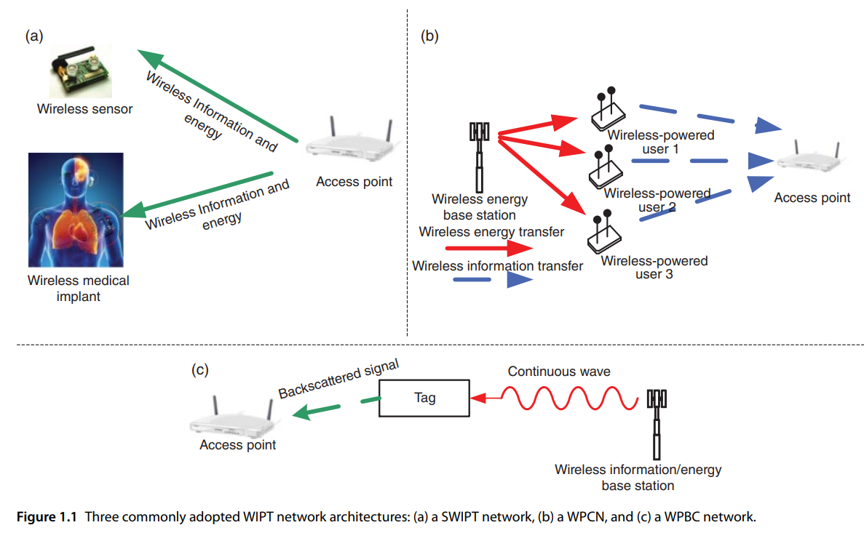

Slide 69
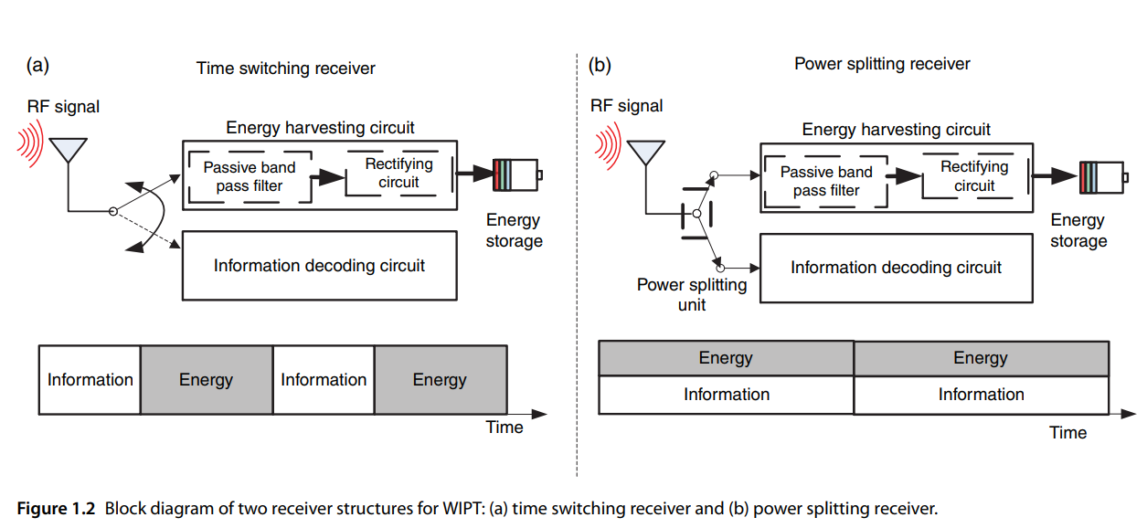

Slide 70
